Slide 1
What is ML?
“Field of study that gives computers the capability to learn without being explicitly programmed”.
-Arthur Samuel

Slide 2
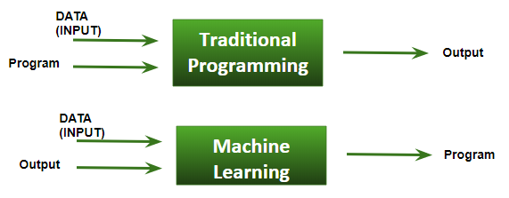

Slide 3
Basic Difference in ML and Traditional Programming?
Traditional Programming : We feed in DATA (Input) + PROGRAM (logic), run it on machine and get output.
Machine Learning : We feed in DATA(Input) + Output, run it on machine during training and the machine creates its own program(logic), which can be evaluated while testing.

Slide 4
A computer program is said to learn from experience E with respect to some task T and some performance measure P, if its performance on T, as measured by P, improves with experience E.

Slide 5

Data in Machine Learning

Slide 6
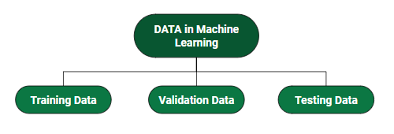

Slide 7
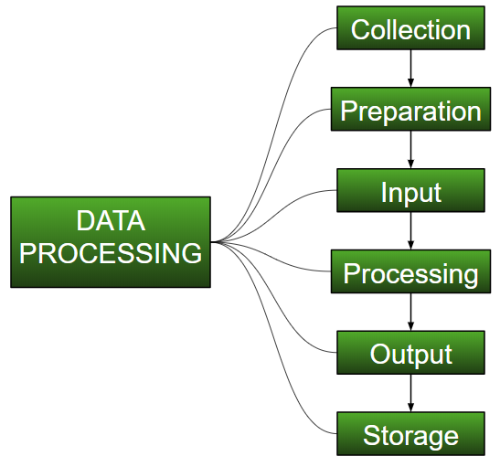
Data Preprocessing

Slide 8
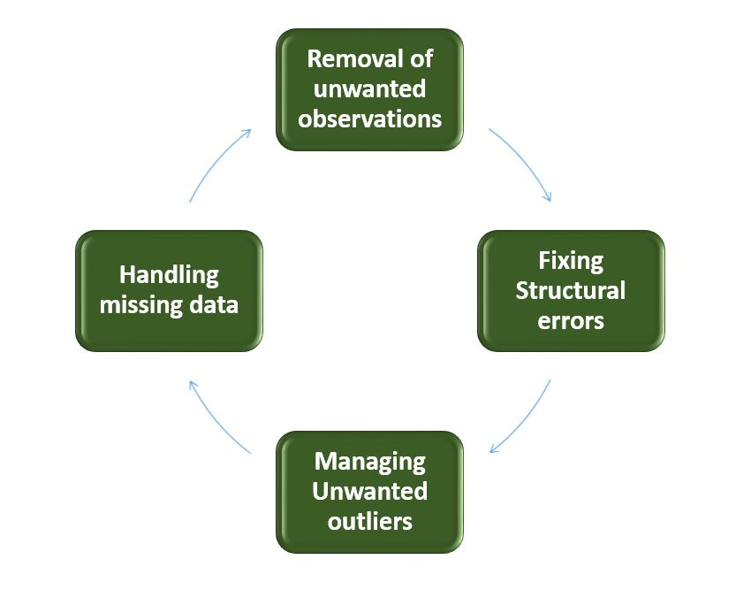
Data Cleansing

Slide 9
Rescale data.
Standardize data.
Normalize data.
Binarize data.

